Slide 1


Introduction to Python – Week 8
Mark Smith

Slide 2
Course outline
Lesson 1 – Getting Started: Introduction and Arithmetic Operators
Lesson 2 – Types and Variables
Lesson 3 – Functions
Lesson 4 – Conditional Statements
Lesson 5 – Further Conditionals and Recursion
Lesson 6 – Functions with Return Values
Lesson 7 – Loops, Lists and Turtles
Lesson 8 – Dictionaries
Lesson 9 – Tuples
Lesson 10 – Project

Slide 3
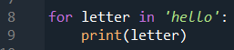
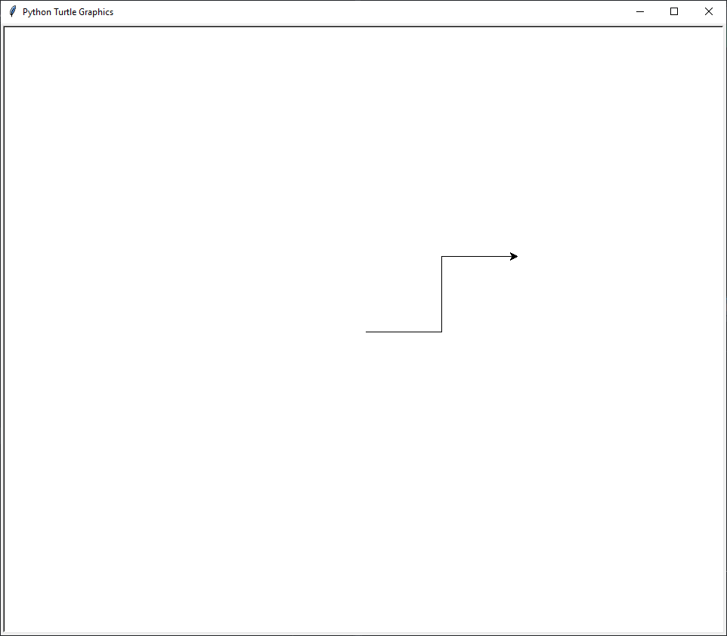
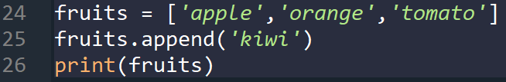
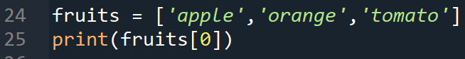
Last Week – Loops, Lists and Turtles
Last week we looked at:
What are loops?
What are lists?
What are methods?
What is Turtle?

Slide 4
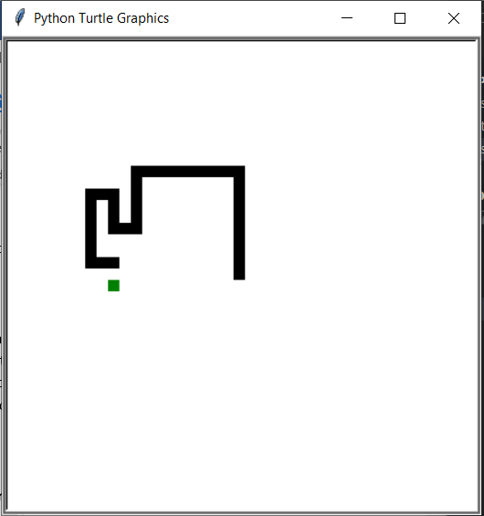
This week - Snake
This week we will:
Build a game in Python – Snake!

Slide 5
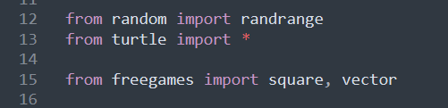
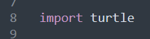
Freegames – import statement
These are the import statements we use for our game
Previously we saw this

Slide 6
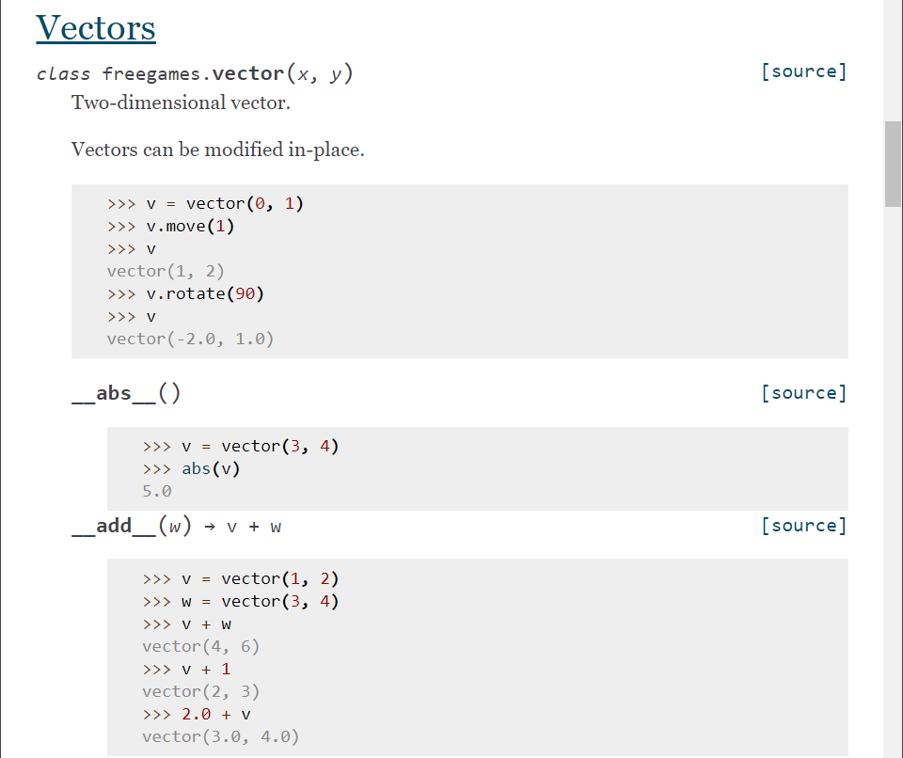
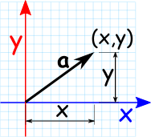
Freegames – what is vector?
Now, the vector object comes from freegames and we can see how it works on the freegames website

Slide 7
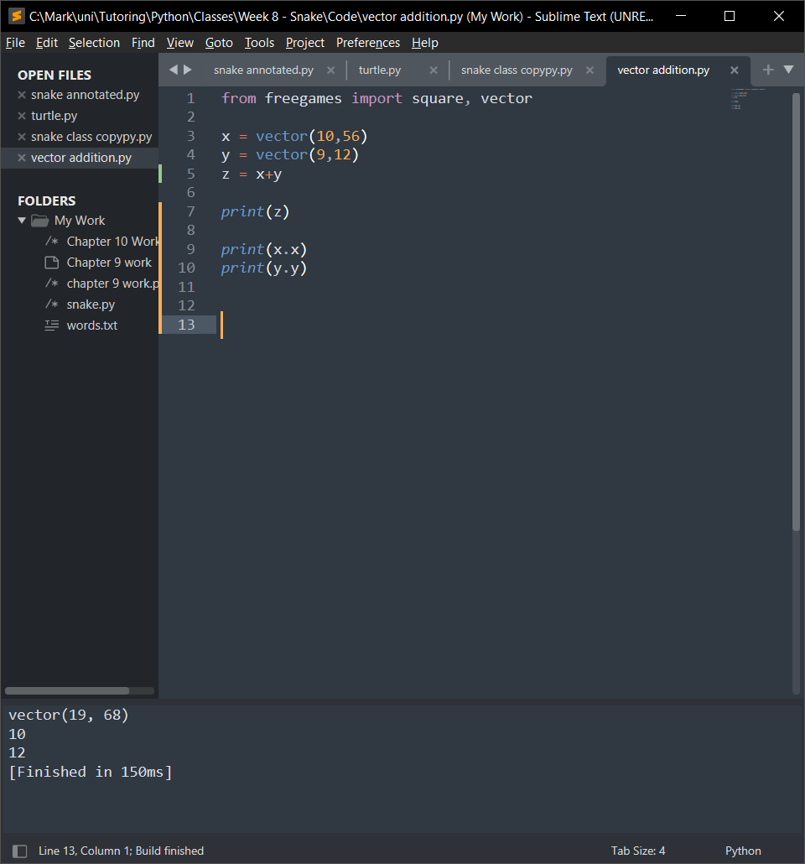
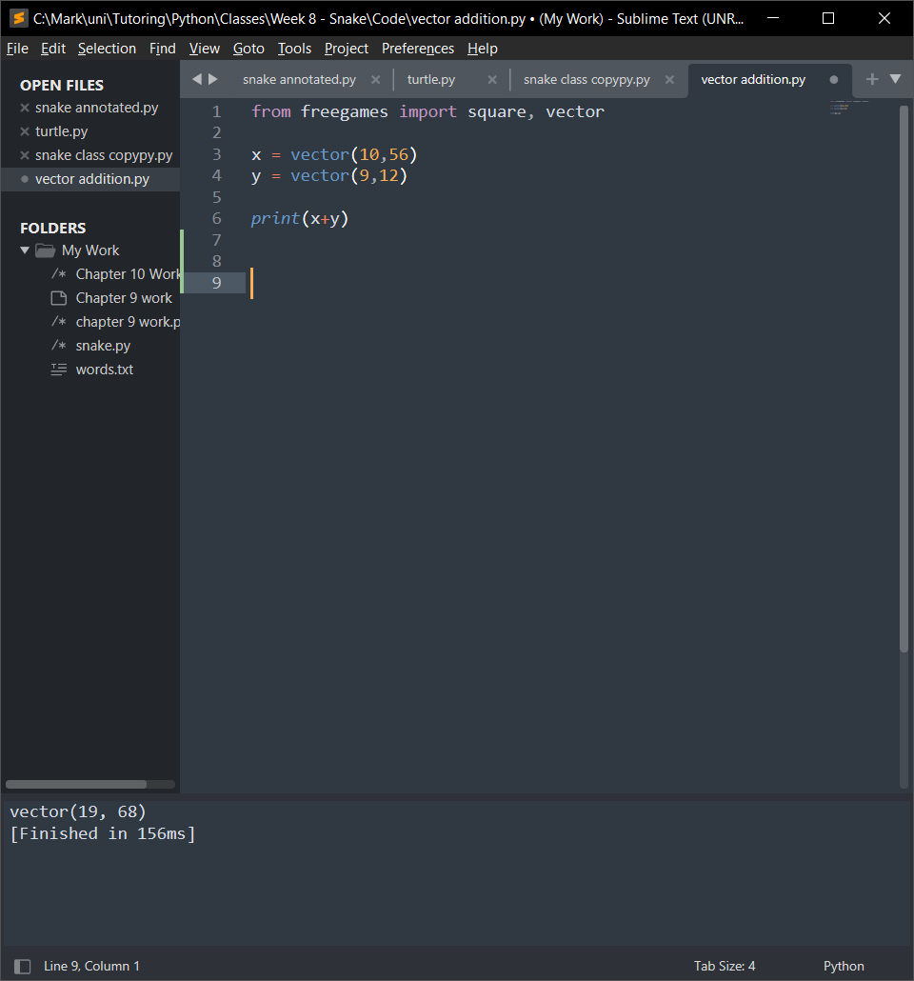
Freegames – vector addition
What will be the result of the following code?

Slide 8
Freegames – vector addition
What will be the result of the following code?
Now we can look at the next part of the code

Slide 9
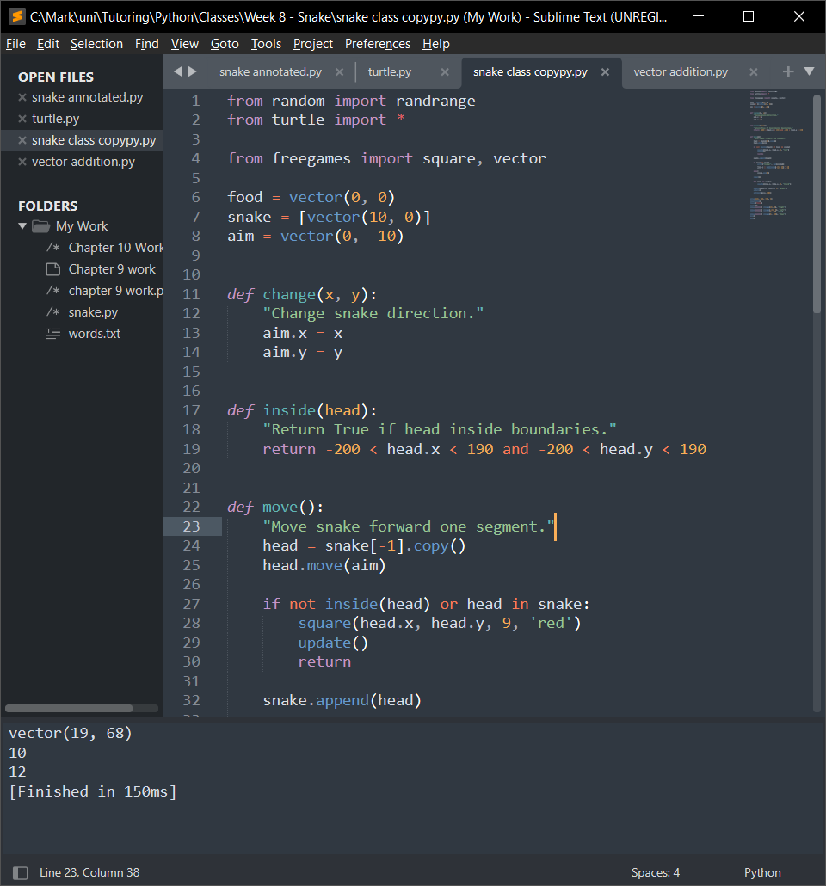
Freegames
Now, the next section of code:

Slide 10
Freegames – change function

Slide 11
Freegames – Inside function
Returns True if the x and y coordinates of head is inside the window
Note: Head is a vector

Slide 12
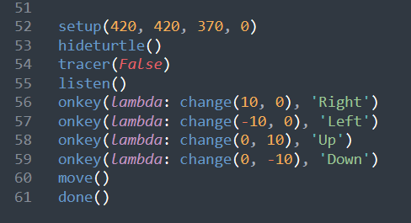
Freegames – End section of code
Turtle Docs

Slide 13
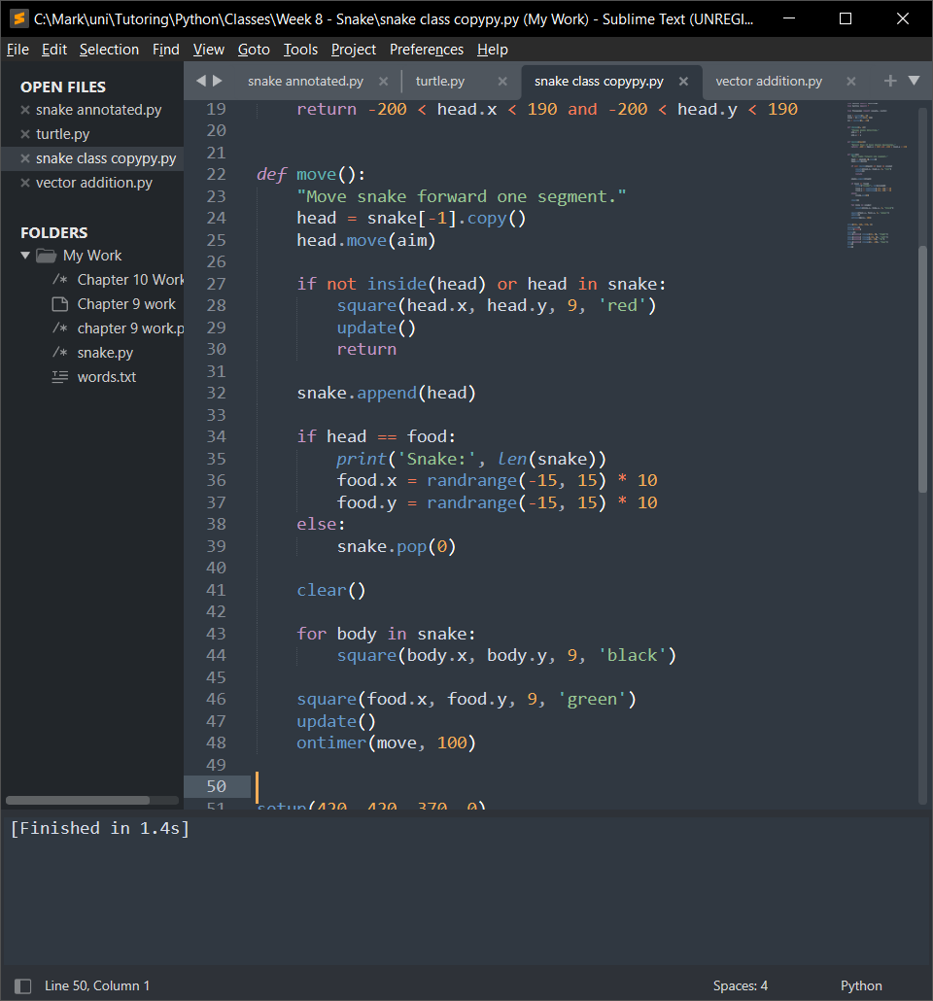
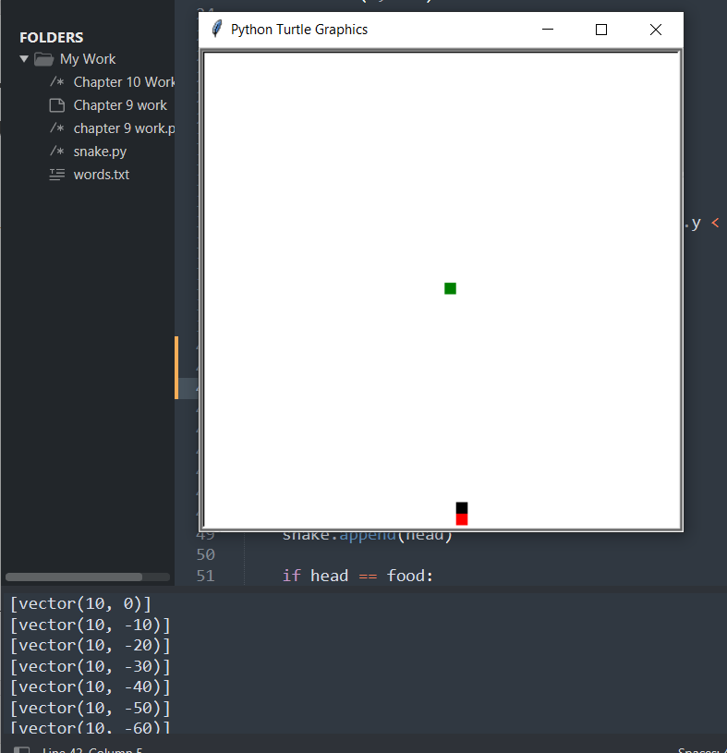
Freegames – move function

Slide 14
Freegames – move function

Slide 15
Freegames – move function

Slide 16
Freegames – move function

Slide 17
Freegames – move function

Slide 18
Freegames – move function

Slide 19
Freegames – move function
Saves the location of the front of the snake in head and moves it in the direction of aim
Checks if the snake is inside the play area, if not end the game
Adds the new square to the snake list
When the food is eaten, print the length, add a new food somewhere random otherwise delete the end of the snake
Clear the old drawings and make the body black
Make the food green, update the screen and run move again in 100 seconds

Slide 20
End of class
This week we have looked at:
How to make a game in Python
How to break that game!

